Slide 1


Android Lecture #7
Menu, Tab

Slide 2


Index
Menu
Option Menu
Context Menu
Tab

Slide 3

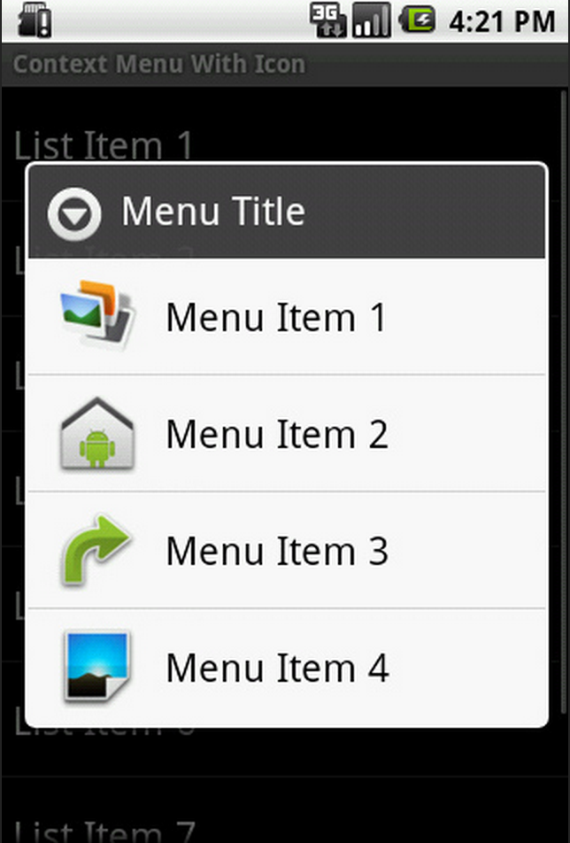
1. Menu
Menu
Option
Menu
Context
Menu

Slide 4
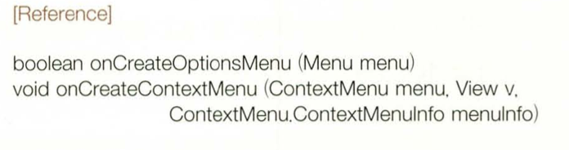
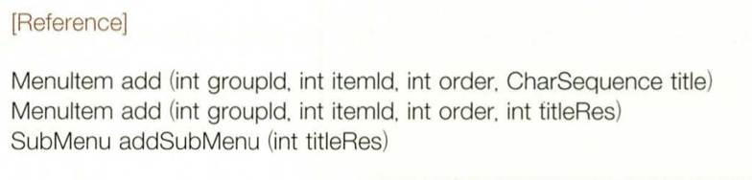
1. Menu
Menu function
Every Activity can set option menu and context menu

Slide 5
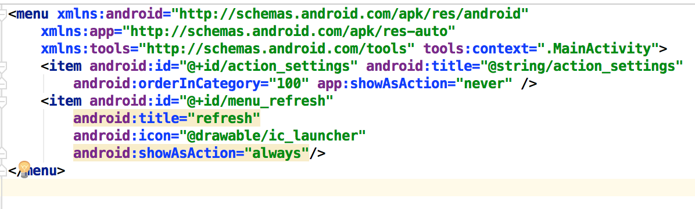
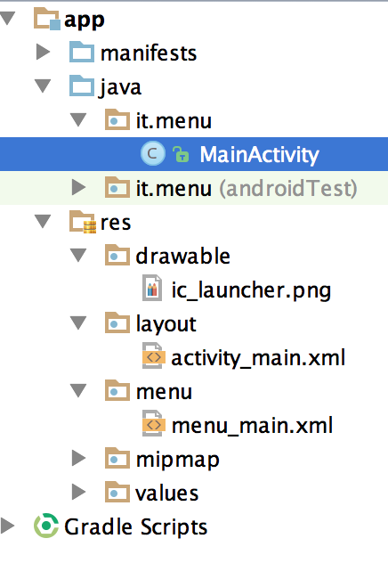
1. Menu
Option Menu source (menu_main.xml)
showAsAction | Explanation
always | Always place this item in the Action Bar.
never | Never place this item in the Action Bar.
ifRoom | Only place this item in the Action Bar if there is room for it.
withText | Also include the title text with the action item.

Slide 6
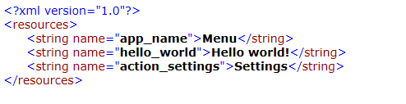
1. Menu
Option Menu source (value/strings)

Slide 7
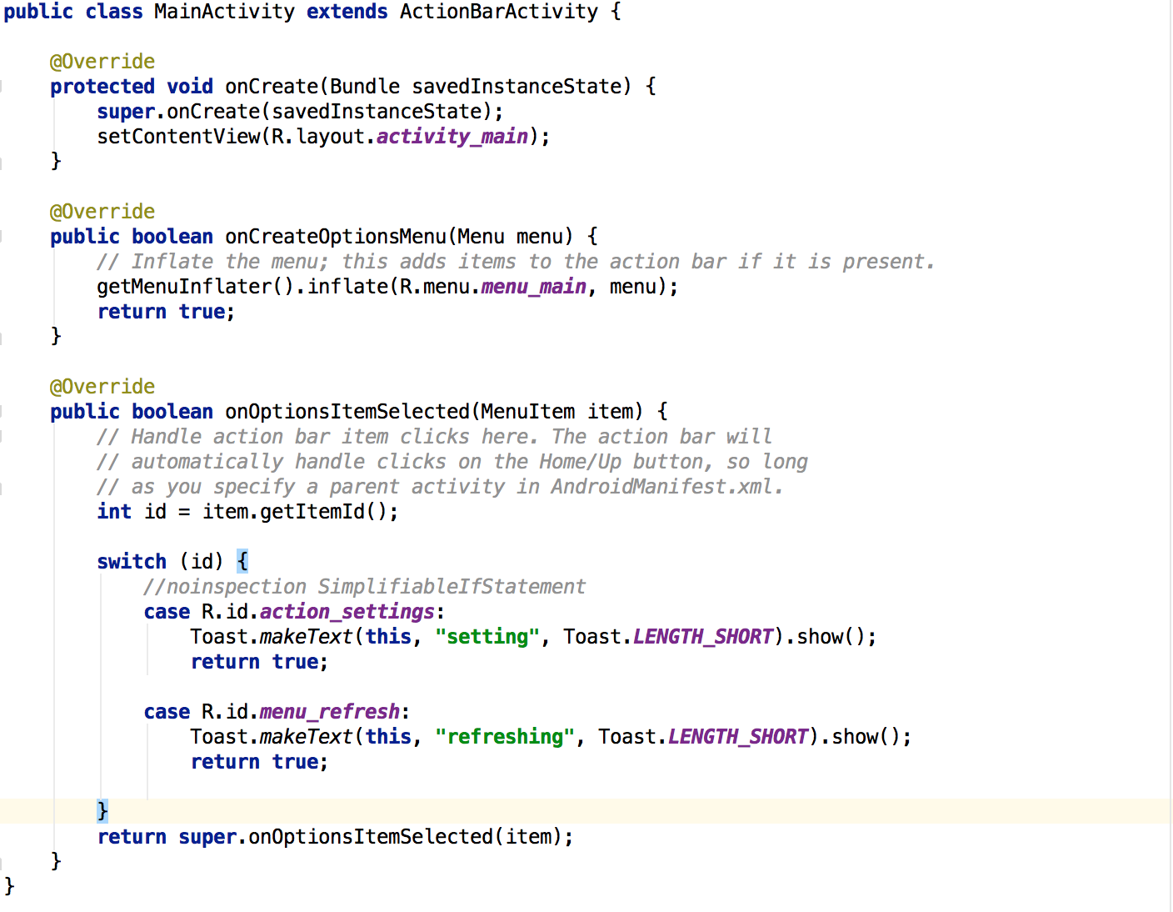
1. Menu
Option Menu source (MainActivity.java)

Slide 8
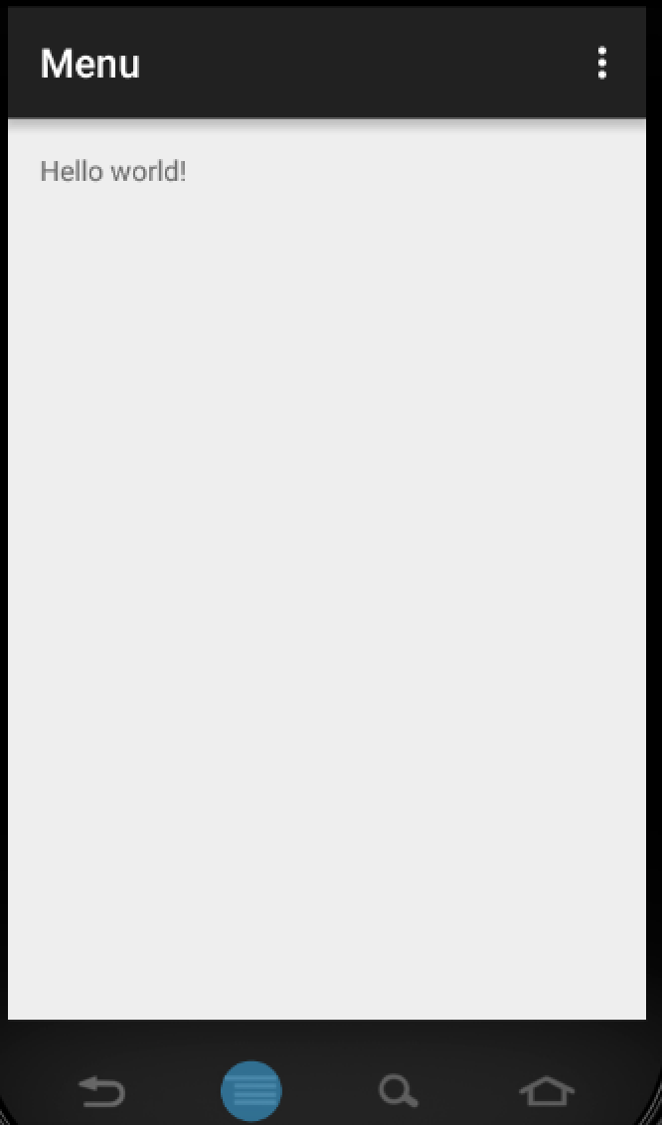
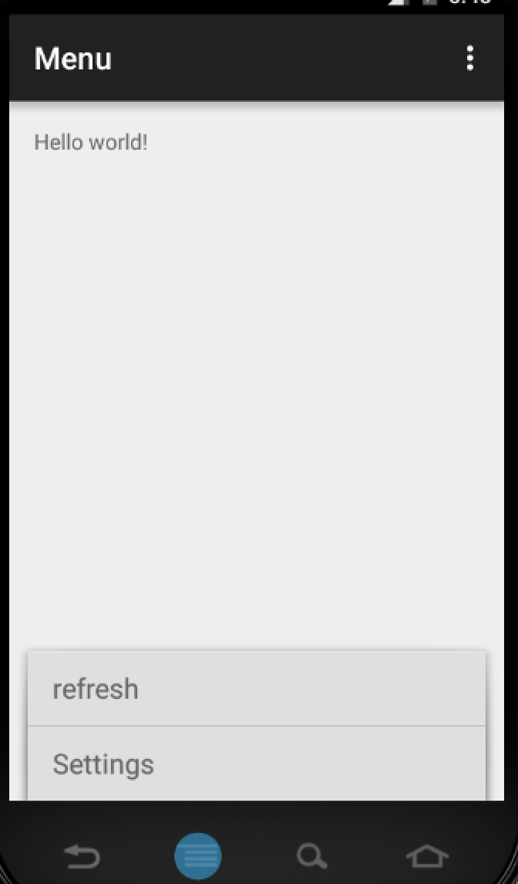
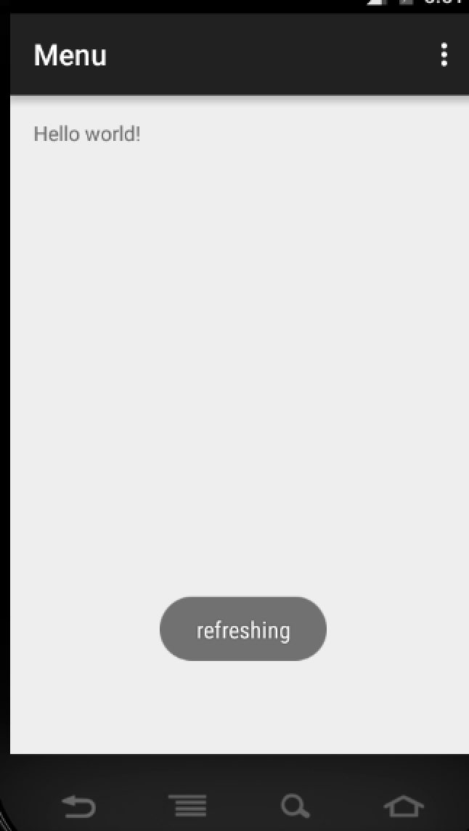
1. Menu
Running screen

Slide 9
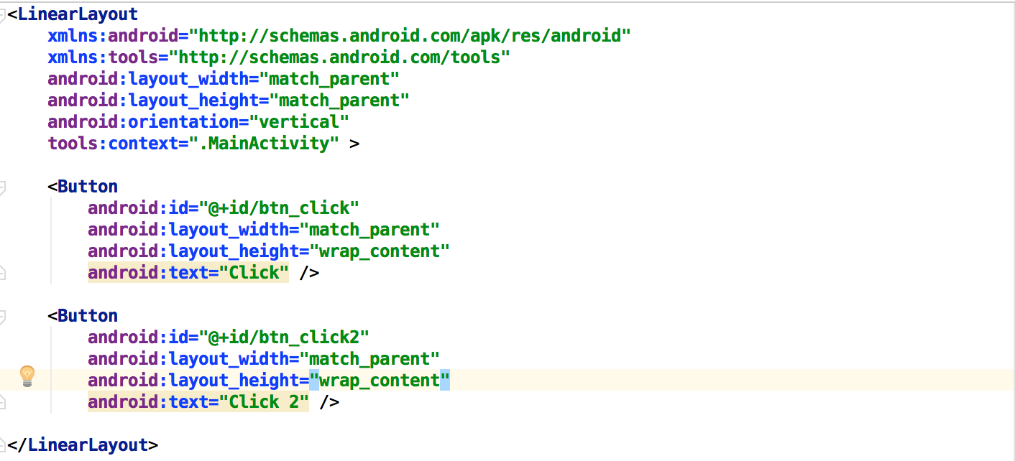
1. Menu
Context Menu (activity_main.xml)

Slide 10
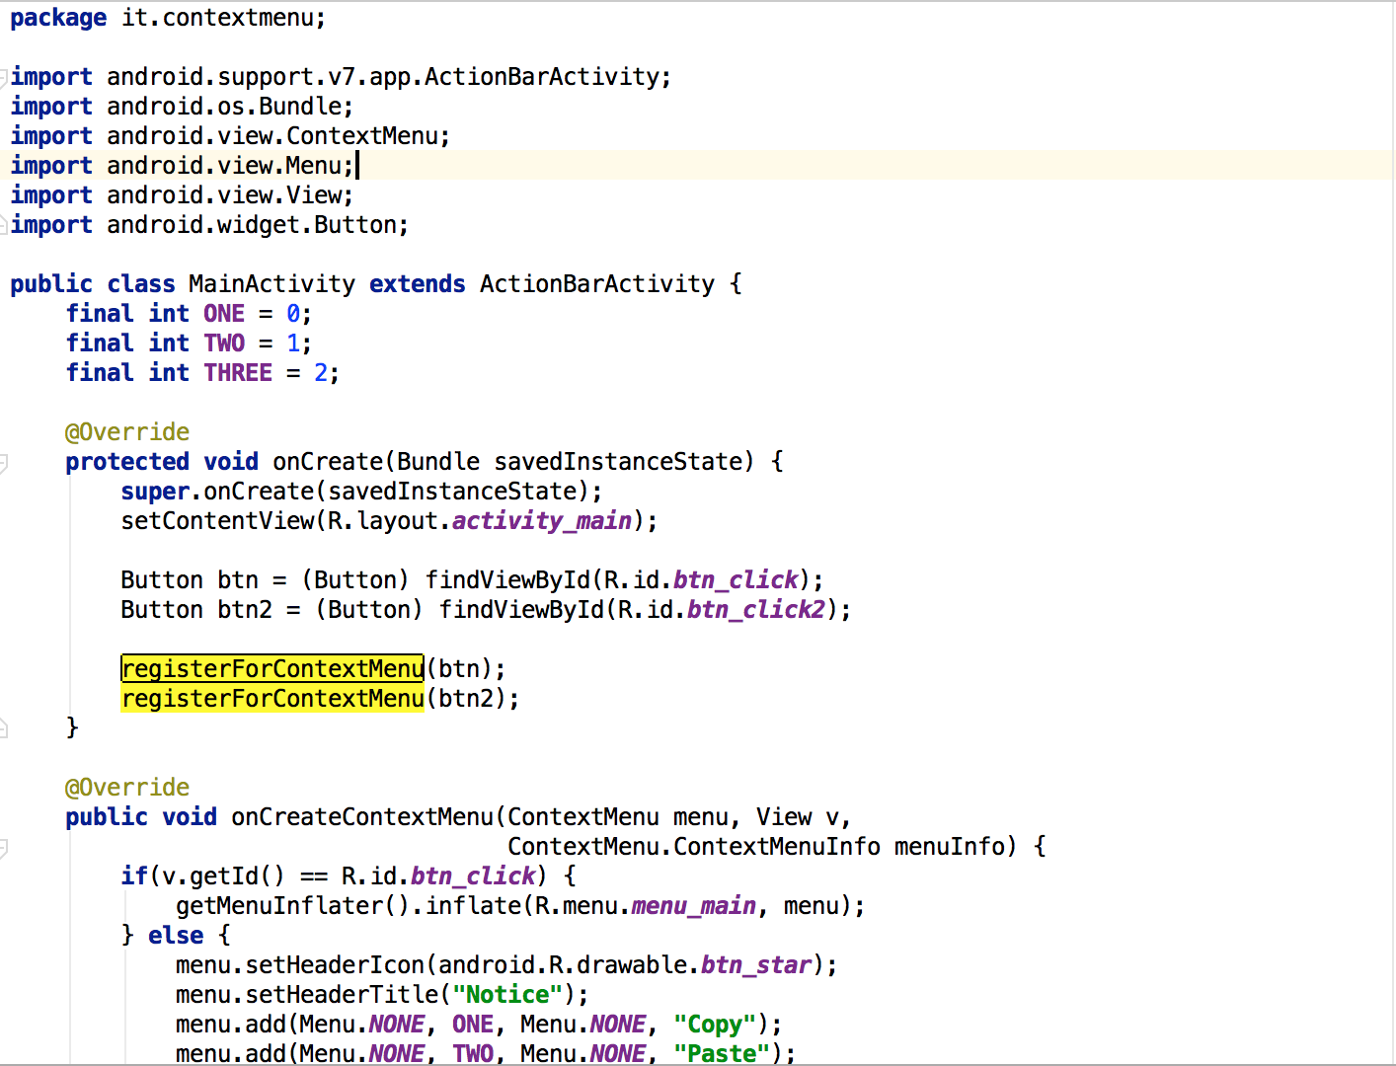
1. Menu
Context Menu (MainActivity.java)

Slide 11

1. Menu
Context Menu (MainActivity.java)
registorForContextMenu

Slide 12
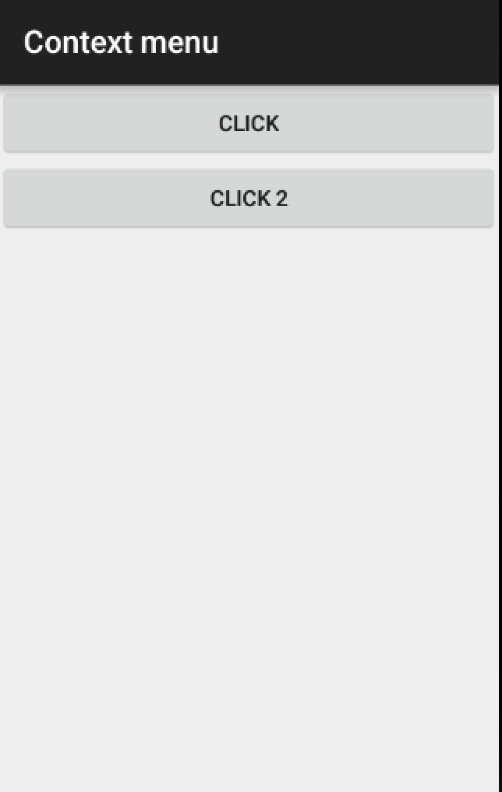
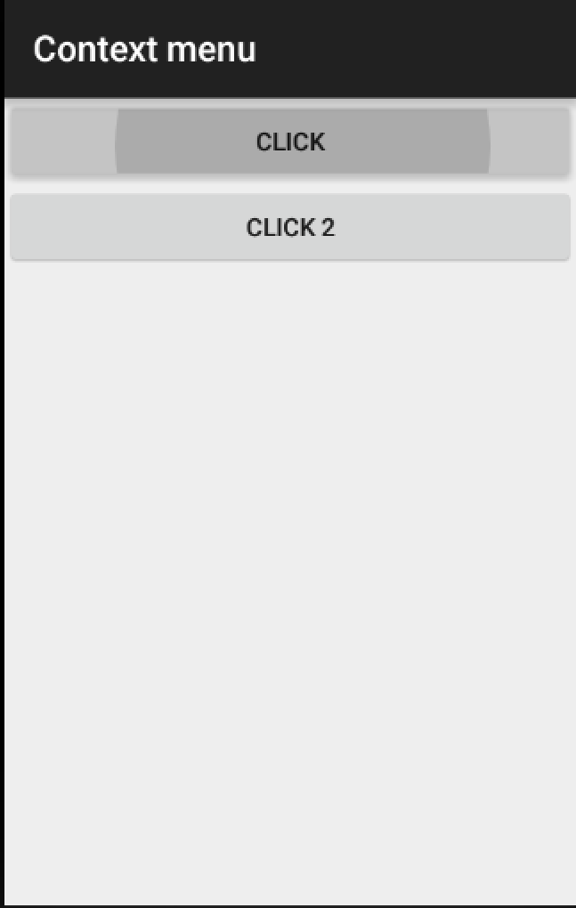
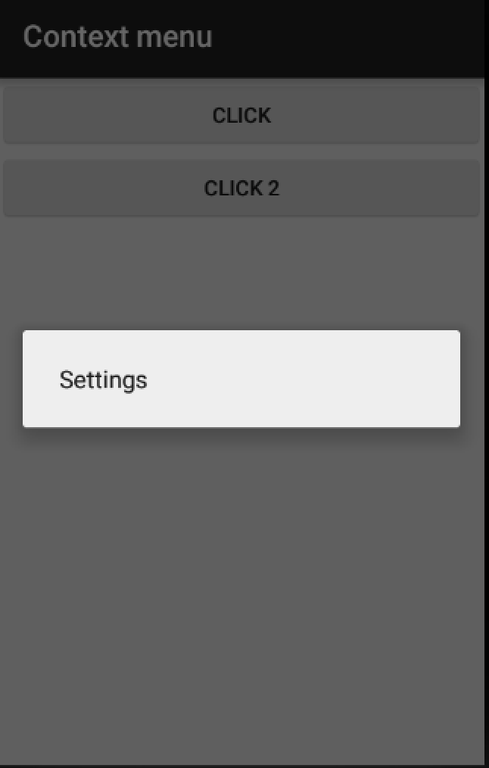
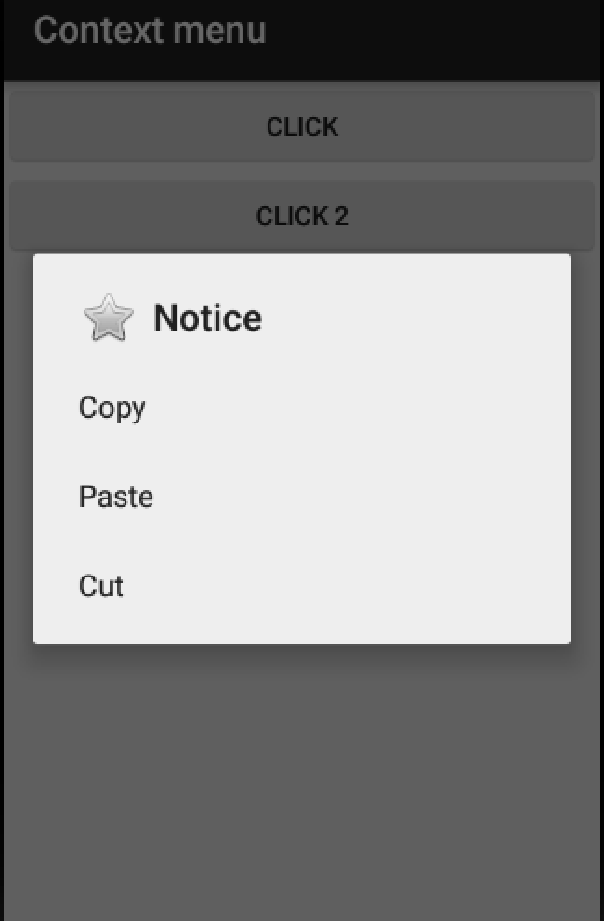
1. Menu
Running Screen
Click
Click 2

Slide 13
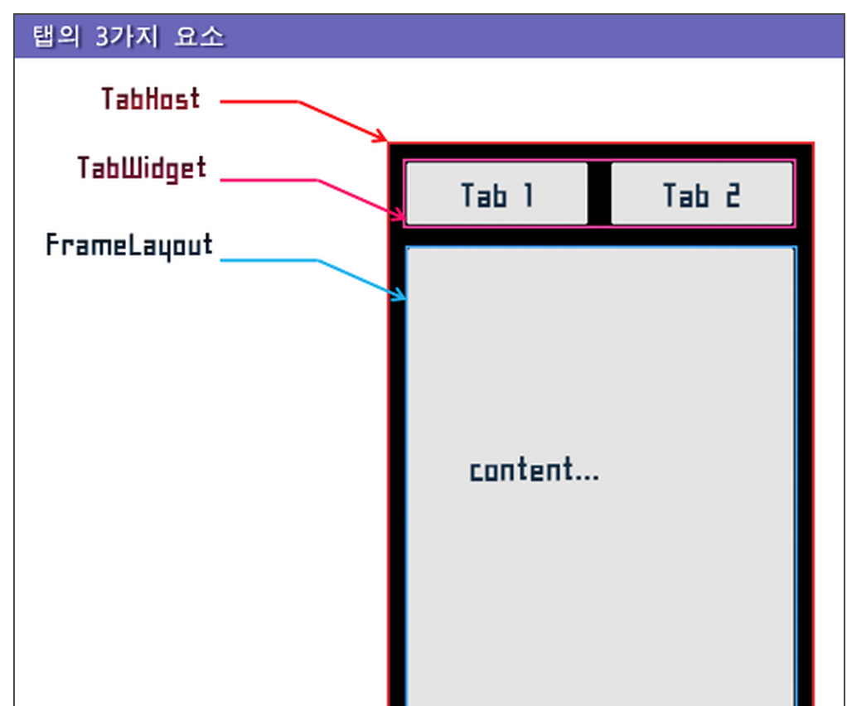
2. Tab
Tab Component
TabHost : TabHost is container which holds TabWidget and FrameLayout
TabWidget : Tab collection (text + icon )
FrameLayout : Layout that holds content

Slide 14
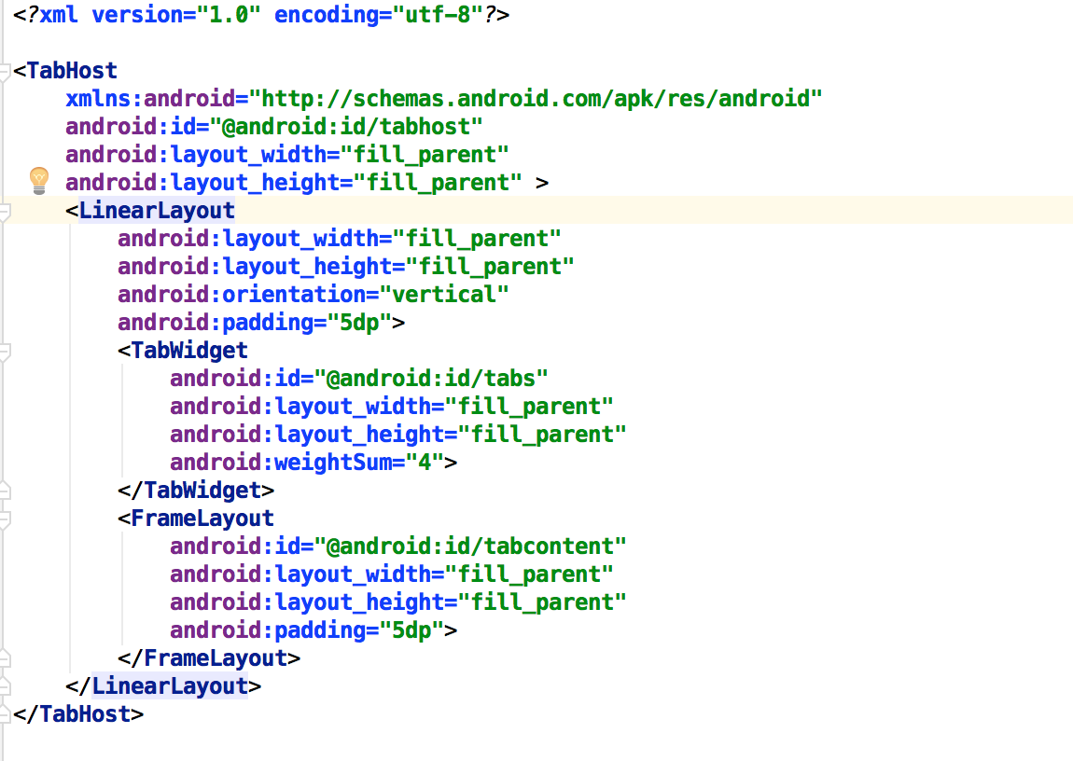
2. Tab
Tab Source(actvity_main.xml)

Slide 15
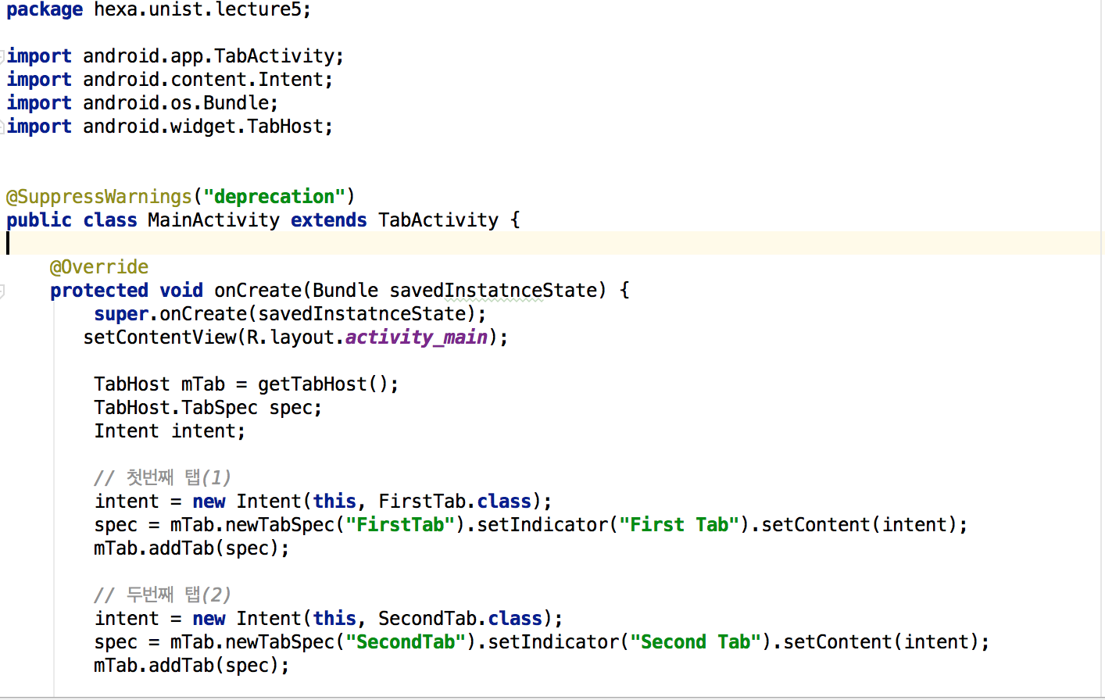
2. Tab
Tab Source(MainActvity.java)

Slide 16
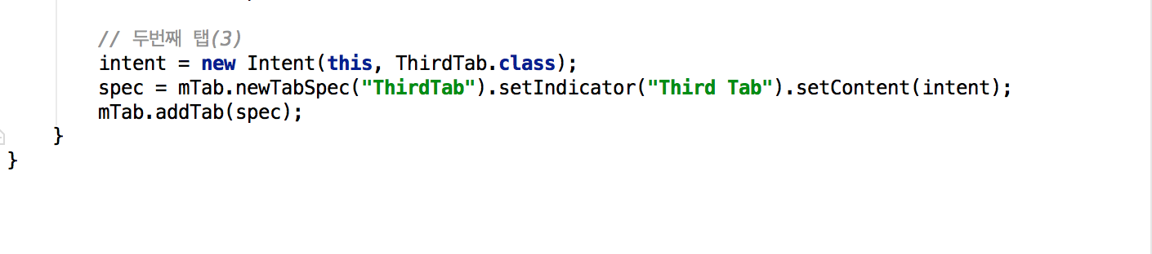
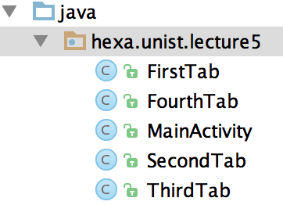
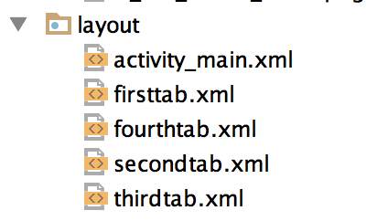
2. Tab
Tab Source(MainActvity.java)
Add file

Slide 17
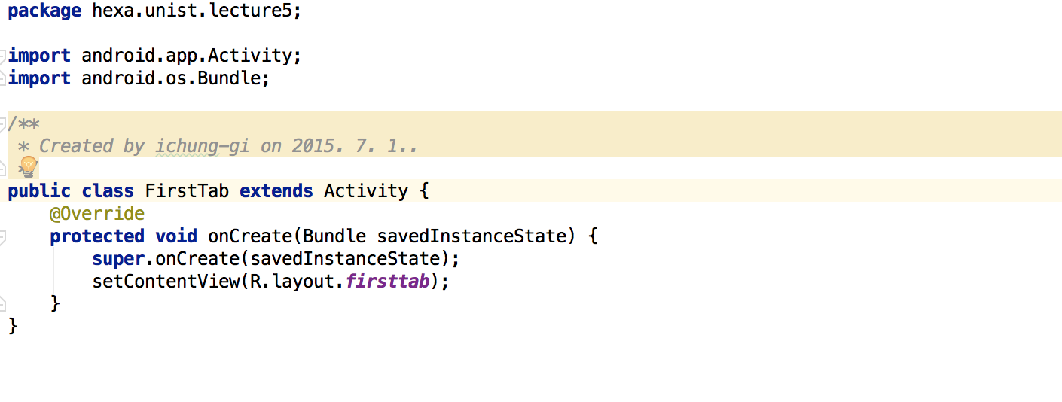
2. Tab
Tab Source(FirstTabActivity.java)

Slide 18
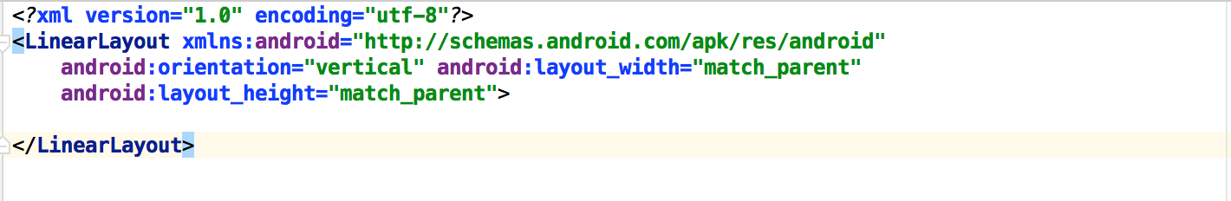
2. Tab
Tab Source(FirstTabActivity.java)

Slide 19
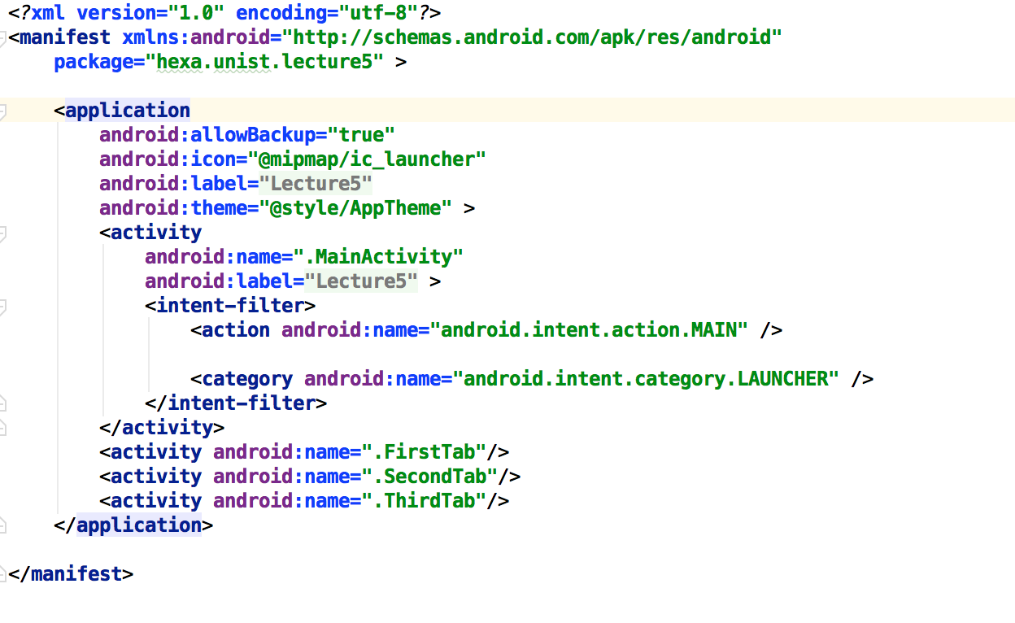
2. Tab
Tab Source(AndroidManifest.xml)

Slide 20
Thank you!

